Slide 1
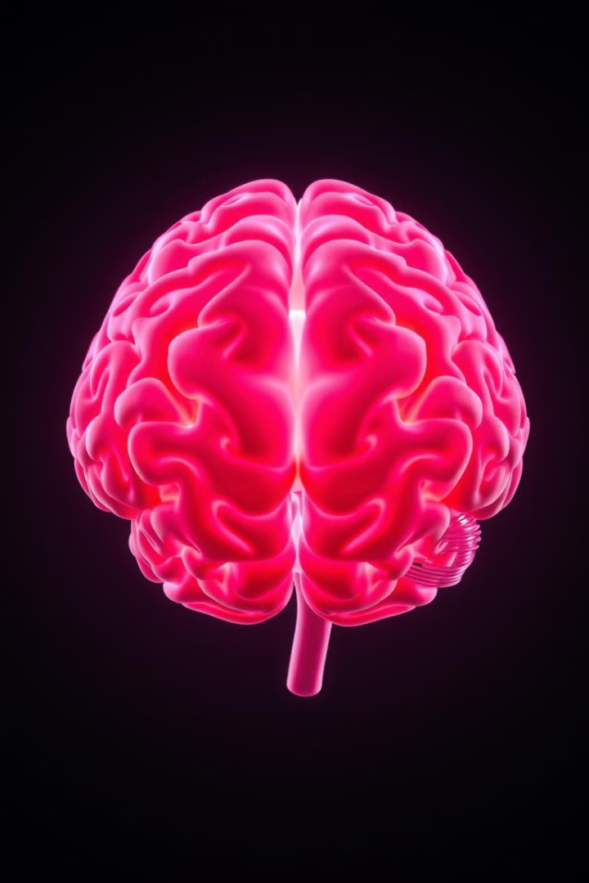

Image-Based Deep Learning in EEG+fNIRS
When EEG+fNIRS data is transformed into images and processed using deep learning models, several important insights can be gained. This leads to applications in neuroscience, medicine, cognitive science, and brain-computer interfaces (BCIs). Our research focuses on leveraging these insights to overcome the limitations of traditional methods. By converting complex time-series signals into visually interpretable images, we unlock the potential for more accurate and versatile brain signal analysis. BY MEGHANA SUNIL 23BDS1165 SHRAVYA V 23BDS1162

Slide 2
Insights Gained from Processing EEG/fNIRS Images
A. Cognitive & Mental State Recognition
Detect mental workload, fatigue, stress, or focus levels.
Identify sleep stages (deep sleep, REM, light sleep) from EEG spectrograms.
Assess cognitive engagement for applications in education and gaming.
Example: A CNN model trained on EEG spectrograms can classify whether a student is focused or distracted.
B. Brain-Related Disorder Diagnosis
Epilepsy detection: Identify seizure patterns in EEG spectrograms.
Stroke assessment: Analyze brain oxygenation changes in fNIRS heatmaps.
Neurodegenerative diseases: Detect early signs of Parkinson’s or Alzheimer’s.
Example: Vision Transformers can analyze EEG heatmaps to detect seizures in real time.

Slide 3
C. Thought Reconstruction (Mind-Reading AI)
Reconstruct images from brain activity (brain-to-image synthesis).
Understand visual perception and how the brain processes images.
Generate brain activity maps that reflect what a person is imagining.
Example: GANs can recreate blurry images of what a person is looking at, using EEG-to-image synthesis.
D. Brain-Computer Interfaces (BCIs)
Enable hands-free communication for paralyzed patients.
Control prosthetic limbs using brain activity signals.
Assist in VR/AR applications by detecting user intentions.
Example: EEG spectrograms are classified in real-time to determine user intent, allowing brain-controlled typing or movement.

Slide 4
Why is This a Necessity?
A. Overcoming Limitations of Raw EEG/fNIRS Data
Traditional EEG and fNIRS data are complex time-series signals, making them difficult to interpret directly. Converting them into images makes them:
Easier to analyze using powerful deep learning models (CNNs, Transformers).
More interpretable for doctors, researchers, and AI systems.
B. Advancing Neuroscience & Medicine
By analyzing brain activity as images, we can:
Improve early disease diagnosis (epilepsy, Alzheimer’s, stroke).
Enhance mental health monitoring (stress, fatigue detection).
Personalize treatments based on brain activity patterns.
C. Enabling Next-Gen Brain-Computer Interfaces (BCIs)
Helps disabled individuals communicate via brain signals.
Improves brain-controlled devices (prosthetics, robotic limbs).
Enhances AR/VR experiences by integrating brain activity into technology.

Slide 5
How Our Research Improves Upon Existing Models Like MDNF
Our research enhances multimodal fusion by converting both EEG & fNIRS signals into 2D images, allowing CNNs and vision transformers to extract spatial-temporal features jointly. We incorporate Vision Transformers, GANs, or Diffusion Models to enhance image understanding, generate synthetic brain data, and handle missing signals. We also implement early or hybrid fusion, possibly using cross-attention mechanisms that learn interactions between EEG and fNIRS across time and space. This captures deeper correlations between brain activity and blood flow, improving prediction accuracy.

Slide 6
How Our Research Is Different?
Real-Time Readiness & Optimization: Can be used in portable or wearable EEG-fNIRS headsets in real-world applications.
Explainability & Visualization: Makes our model explainable to doctors, researchers, and patients — crucial for medical adoption.
Application Scope: Targets broader applications like mental health, cognitive workload, brain-to-image synthesis, and personalized neurofeedback.
The high accuracy and precise feature utilization of our model demonstrates the potential in clinical applications for neurodiagnostics and rehabilitation, thereby paving the method for patient-specific therapeutic strategies.

Slide 7
References
C. Bunterngchit, J. Wang and Z. -G. Hou, "Simultaneous EEG-fNIRS Data Classification Through Selective Channel Representation and Spectrogram Imaging," in IEEE Journal of Translational Engineering in Health and Medicine, vol. 12, pp. 600-612, 2024, doi: 10.1109/JTEHM.2024.3448457. keywords: {Electroencephalography;Functional near-infrared spectroscopy;Feature extraction;Brain-computer interfaces;Neuroimaging;Fourier transforms;Deep learning;Brain-computer interfaces;multimodal neuroimaging;short-time Fourier transform;spectrogram imaging}
Khan H, Khadka R, Sultan MS, Yazidi A, Ombao H and Mirtaheri P (2024) Unleashing the potential of fNIRS with machine learning: classification of fine anatomical movements to empower future brain-computer interface. Front. Hum. Neurosci. 18:1354143. doi: 10.3389/fnhum.2024.1354143

